Slide 1
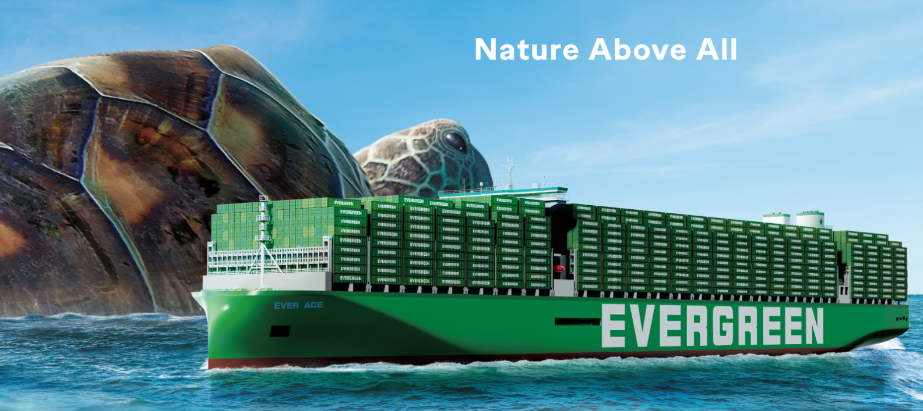
2025
LAAM Meeting (CARB)
By LAD/EGA/ELA 2025.FEB.27~28
By LAD/EGA/ELA

Slide 2
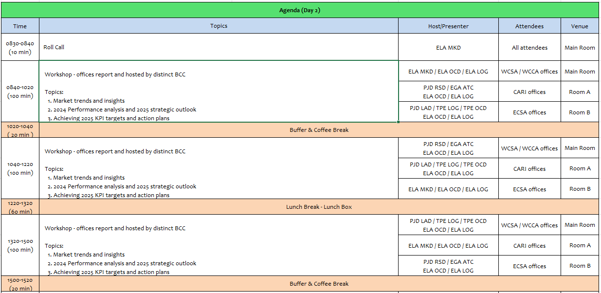
2

Slide 3
02
MIS
(COSTA RICA include NICARAGUA)

Slide 4
Performance/Space(2024) and 2025 Market Review (CR+NI)
Subject | Segments | BCC | 2024 Target TTL Loading(TEU) | 2024 JAN~DEC TTL Loading(TEU) | Achievement (%) | 2025 JAN~DEC TTL Loading(TEU) | Market Review & Action Plan (How to achieve 2025 target?)
 |  |  | (A) | (B) | (B)/(A) | Target
Trade Lane | F.E. => CR+NI IMP. (C Trade) | LAD | 127 | 212 | 167% | 245
 | F.E. => CR+NI IMP. (Q Trade) | LAD | 6,221 | 6,354 | 102% | 7,265
 | CR+NI EXP. => F.E. (CF Trade) | LAD | 5,483 | 5,106 | 93% | 5,140
4

Slide 5
Performance/Space(2024) and 2025 Market Review (CR+NI)
Subject | Segments | BCC | 2024 Target TTL Loading(TEU) | 2024 JAN~DEC TTL Loading(TEU) | Achievement (%) | 2025 JAN~DEC TTL Loading(TEU) | Market Review & Action Plan (How to achieve 2025 target?)
 |  |  | (A) | (B) | (B)/(A) | Target
Trade Lane | CR+NI ⬄ USEC (609+610 Trade) | EGA-ATC | 1,000 | 1,476 | 147% | 1,800
 | CR+NI ⬄ CARB+WCCA (CB Trade) | ELA | 2,350 | 1,188 | 51% | 1,350
 | CR+NI ⬄ WCSA (CW+WC Trade) | ELA | 500 | 797 | 159% | 650
 | CR+NI ⬄ USEC (622+623 Trade) | ELA | 1,100 | 1,710 | 155% | 1,500
5

Slide 6
Topic discussion (CR+NI)
Commercial side:
Future Plan Suggestion:
6

Slide 7
Topic discussion (CR+NI)
Future market forecast in 2025 (Pessimistic / Optimistic / Remain the same)?
Economic background.
Market share and Loading volume prospect 2025 (Long Haul)
 | Get worse | Improve | Stay the same
2025
7

Slide 8
ECD/IMD Topic discussion (CR+NI)
ECD KPI | Item | 2023 | 2024 | Diff | Action Plan in 2025
ECD KPI | Storage
 | Lift on/off
 | Reposition
 | M & R
IMD KPI | Cost Saving Project
 | 90% Onboard within 7 Days
 | No Personal Negligence
Topic
Aged Container Selling / Free Reposition Plan
  A
  B
8

Slide 9
OCD/OPD Topic discussion (CR+NI)
 |  | 2023 | 2024 | Diff | Action Plan in 2025
OPD KPI | BOA
 | Port Stay
 | Productivity
OCD KPI | Incentive
 | Empty Storage
 | Rate Reduction
Topic
Terminal info update (expansion/dredge/crane)
  A
  B
9

Slide 10
03
CRE
(CURACAO)

Slide 11
Performance/Space(2024) and 2025 Market Review (CW)
Subject | Segments | BCC | 2024 Target TTL Loading(TEU) | 2024 JAN~DEC TTL Loading(TEU) | Achievement (%) | 2025 JAN~DEC TTL Loading(TEU) | Market Review & Action Plan (How to achieve 2025 target?)
 |  |  | (A) | (B) | (B)/(A) | Target
Trade Lane | F.E. => CW IMP. (C Trade) | LAD | 332 | 566 | 170% | 588 | Continue regaining support from lost ac now that rates have dropped from Usd10K/ 4Sh levels. Our main competitors CMA/CGM and Mearsk has been facing major delays at JMKSN / COCTG since last year, customers moving back slowly to EMC service. Continue improving own SQ volume.
 | CW ⬄ USEC (609+610 Trade) | EGA-ATC | 20 | 16 | 80% | 20 | Continue chasing any 609/610 opportunities in the market. Hard to compete with King Ocean & Seaboard with our high Ocean Freight Rates. Significant USEC volume move out of Port Everglades/ Miami area via direct service of King Ocean.
 | CW ⬄ CARI (CC Trade) | EGA-ATC | 20 | 23 | 115% | 20 | Continue promoting CARB – CW / CARB – CW service in order to regain support. Hard to compete with King Ocean, Seaboard Marine and Sealand/ Maersk at current EMC Ocean Freight Rates. DO – CW is dominated by local carrier Don Andres with weekly direct service with transit of 2 days.
11

Slide 12
Performance/Space(2024) and 2025 Market Review (CW)
Subject | Segments | BCC | 2024 Target TTL Loading(TEU) | 2024 JAN~DEC TTL Loading(TEU) | Achievement (%) | 2025 JAN~DEC TTL Loading(TEU) | Market Review & Action Plan (How to achieve 2025 target?)
 |  |  | (A) | (B) | (B)/(A) | Target
Trade Lane | CW ⬄ WCSA (CW+WC Trade) | ELA | 10 | 0 | 0% | 10 | No service, no transhipment options.
 | CW ⬄ WCCA+CARO (CB Trade) | ELA | 15 | 0 | 0% | 10 | - No service, no transhipment options
12

Slide 13
Topic discussion (CW)
Commercial side:
FE to AW/CW rate levels are slowly decreasing from mid 2024 levels, this in line with latest market trends. Lost accounts are slowly returning due to better transit as competition is experiencing frequent delays (bad performance)
Colombia is a substantial / attractive market for which we receive frequent enquires, however we are not participating due to feeder-cost and unreliable feeder schedule.
Panama is a substantial / attractive market for which we receive frequent enquires, however we are not participating due to feeder-cost
AW/CW export volumes are extremely limited, consisting of waste materials (metal scrap/ drained batteries/waste paper) to FE & EU. We are not permitted to accept these commodities by the principle, due to Basel conference restrictions.
Future Plan Suggestion:
Continuing chasing all our lost accounts on the various trades.
Suggest to review / renegotiate CFS feeder contract for lower feeder-rates / offer rates in line with competition.
Promoting AW/ CW service to CARI in order to secure support for any incidental export cargo such as removal goods.
13

Slide 14
Topic discussion (CW)
Future market forecast in 2025 (Pessimistic / Optimistic / Remain the same)?
Economic background.
AW/CW economies are growing, mainly by tourism.
CW is more focused on EU goods, AW is more focused on USA goods
Lot of construction activities, mainly for tourism
Inflation is rising, even though certain goods are price limited by Government decree.
Still no VE biz due to political situation VE – USA governments.
New elections coming up in Curacao, March 2025.
Market share and Loading volume prospect 2025 (Long Haul)
Current market share can not be indicated in % as neither government instances nor stevedore provide import statistics.
There is a recovery on the ASI – CARI trade and we hope to be able to extend this recovery also on our other trades.
Have many external factors to make a proper forecast (Politics US, War Ukraine, situation Middle East, situation Venezuela)
 | Get worse | Improve | Stay the same
2025 |  | x
14

Slide 15
04
SMS
(HAITI)

Slide 16
Performance/Space(2024) and 2025 Market Review (HT)
Subject | Segments | BCC | 2024 Target TTL Loading(TEU) | 2024 JAN~DEC TTL Loading(TEU) | Achievement (%) | 2025 JAN~DEC TTL Loading(TEU) | Market Review & Action Plan (How to achieve 2025 target?)
 |  |  | (A) | (B) | (B)/(A) | Target
Trade Lane | F.E. => HT IMP. (C Trade) | LAD | 1,219 | 1,450 | 119% | 1,715
 | HT ⬄ CARI+CARO (CB Trade) | ELA | 1,000 | 222 | 22% | 500
16

Slide 17
Performance/Space(2024) and 2025 Market Review (HT)
Subject | Segments | BCC | 2024 Target TTL Loading(TEU) | 2024 JAN~DEC TTL Loading(TEU) | Achievement (%) | 2025 JAN~DEC TTL Loading(TEU) | Market Review & Action Plan (How to achieve 2025 target?)
 |  |  | (A) | (B) | (B)/(A) | Target
Trade Lane | HT ⬄ WCSA+WCCA (CW+WC+CB Trade) | ELA | 1,000 | 60 | 6% | 80
 | HT ⬄ USEC (622+623 Trade) | ELA | 500 | 75 | 15% | 250
17

Slide 18
Topic discussion (HT)
Commercial side:
Future Plan Suggestion:
18

Slide 19
Topic discussion (HT)
Future market forecast in 2025 (Pessimistic / Optimistic / Remain the same)?
Economic background.
Market share and Loading volume prospect 2025 (Long Haul)
 | Get worse | Improve | Stay the same
2025
19

Slide 20
ECD/IMD Topic discussion (HT)
ECD KPI | Item | 2023 | 2024 | Diff | Action Plan in 2025
ECD KPI | Storage
 | Lift on/off
 | Reposition
 | M & R
IMD KPI | Cost Saving Project
 | 90% Onboard within 7 Days
 | No Personal Negligence
Topic
Aged Container Selling / Free Reposition Plan
  A
  B
20

Slide 21
OCD/OPD Topic discussion (HT)
 |  | 2023 | 2024 | Diff | Action Plan in 2025
OPD KPI | BOA
 | Port Stay
 | Productivity
OCD KPI | Incentive
 | Empty Storage
 | Rate Reduction
Topic
Terminal info update (expansion/dredge/crane)
  A
  B
21

Slide 22
05
MCD
(DOMINICAN REPUBLIC)

Slide 23
Performance/Space(2024) and 2025 Market Review (DO)
Subject | Segments | BCC | 2024 Target TTL Loading(TEU) | 2024 JAN~DEC TTL Loading(TEU) | Achievement (%) | 2025 JAN~DEC TTL Loading(TEU) | Market Review & Action Plan (How to achieve 2025 target?)
 |  |  | (A) | (B) | (B)/(A) | Target
Trade Lane | F.E. => DO IMP. (C Trade) | LAD | 2,708 | 2,530 | 96% | 4,900
23

Slide 24
Performance/Space(2024) and 2025 Market Review (DO)
Subject | Segments | BCC | 2024 Target TTL Loading(TEU) | 2024 JAN~DEC TTL Loading(TEU) | Achievement (%) | 2025 JAN~DEC TTL Loading(TEU) | Market Review & Action Plan (How to achieve 2025 target?)
 |  |  | (A) | (B) | (B)/(A) | Target
Trade Lane | DO ⬄ USEC (609+610 Trade) | EGA-ATC | 200 | 209 | 104% | 200
 | DO ⬄ CARI (CC Trade) | EGA-ATC | 2,900 | 3466 | 119% | 2,900
24

Slide 25
Performance/Space(2024) and 2025 Market Review (DO)
Subject | Segments | BCC | 2024 Target TTL Loading(TEU) | 2024 JAN~DEC TTL Loading(TEU) | Achievement (%) | 2025 JAN~DEC TTL Loading(TEU) | Market Review & Action Plan (How to achieve 2025 target?)
 |  |  | (A) | (B) | (B)/(A) | Target
Trade Lane | DO ⬄ WCSA (CW+WC Trade) | ELA | 150 | 21 | 14% | 50
 | DO ⬄ WCCA+CARO (CB Trade) | ELA | 300 | 70 | 23% | 100
25

Slide 26
Topic discussion (DO)
Commercial side:
Future Plan Suggestion:
26

Slide 27
Topic discussion (DO)
Future market forecast in 2025 (Pessimistic / Optimistic / Remain the same)?
Economic background.
Market share and Loading volume prospect 2025 (Long Haul)
 | Get worse | Improve | Stay the same
2025
27

Slide 28
ECD/IMD Topic discussion (DO)
ECD KPI | ITEM | 2023 | 2024 | Diff | Action Plan in 2025
ECD KPI | Storage
 | Lift on/off
 | Reposition
 | M & R
IMD KPI | Cost Saving Project
 | 90% Onboard within 7 Days
 | No Personal Negligence
Topic
Aged Container Selling / Free Reposition Plan
  A
  B
28

Slide 29
OCD/OPD Topic discussion (DO)
 | ITEM | 2023 | 2024 | Diff | Action Plan in 2025
OPD KPI | BOA
 | Port Stay
 | Productivity
OCD KPI | Incentive
 | Empty Storage
 | Rate Reduction
Topic
Terminal info update (expansion/dredge/crane)
  A
  B
29

Slide 30
06
LNM
(JAMAICA)

Slide 31
Performance/Space(2024) and 2025 Market Review (JM)
Subject | Segments | BCC | 2024 Target TTL Loading(TEU) | 2024 JAN~DEC TTL Loading(TEU) | Achievement (%) | 2025 JAN~DEC TTL Loading(TEU) | Market Review & Action Plan (How to achieve 2025 target?)
 |  |  | (A) | (B) | (B)/(A) | Target
Trade Lane | F.E. => JM IMP. (C Trade) | LAD | 379 | 339 | 90% | 490
 | JM ⬄ USEC (609+610 Trade) | EGA-ATC | 10 | 9 | 90% | 10
 | JM ⬄ CARI (CC Trade) | EGA-ATC | 25 | 28 | 112% | 25
31

Slide 32
Performance/Space(2024) and 2025 Market Review (JM)
Subject | Segments | BCC | 2024 Target TTL Loading(TEU) | 2024 JAN~DEC TTL Loading(TEU) | Achievement (%) | 2025 JAN~DEC TTL Loading(TEU) | Market Review & Action Plan (How to achieve 2025 target?)
 |  |  | (A) | (B) | (B)/(A) | Target
Trade Lane | JM ⬄ WCSA (CW+WC Trade) | ELA | 10 | 0 | 0% | 10
 | JM ⬄ WCCA+CARO (CB Trade) | ELA | 515 | 204 | 40% | 250
32

Slide 33
Topic discussion (JM)
Commercial side:
Future Plan Suggestion:
33

Slide 34
Topic discussion (JM)
Future market forecast in 2025 (Pessimistic / Optimistic / Remain the same)?
Economic background.
Market share and Loading volume prospect 2025 (Long Haul)
 | Get worse | Improve | Stay the same
2025
34

Slide 35
ECD/IMD Topic discussion (JM)
ECD KPI | ITEM | 2023 | 2024 | Diff | Action Plan in 2025
ECD KPI | Storage
 | Lift on/off
 | Reposition
 | M & R
IMD KPI | Cost Saving Project
 | 90% Onboard within 7 Days
 | No Personal Negligence
Topic
Aged Container Selling / Free Reposition Plan
  A
  B
35

Slide 36
OCD/OPD Topic discussion (JM)
 | ITEM | 2023 | 2024 | Diff | Action Plan in 2025
OPD KPI | BOA
 | Port Stay
 | Productivity
OCD KPI | Incentive
 | Empty Storage
 | Rate Reduction
Topic
Terminal info update (expansion/dredge/crane)
  A
  B
36

Slide 37
07
UMS
(PANAMA)

Slide 38
Performance/Space(2024) and 2025 Market Review (PA)
Subject | Segments | BCC | 2024 Target TTL Loading(TEU) | 2024 JAN~DEC TTL Loading(TEU) | Achievement (%) | 2025 JAN~DEC TTL Loading(TEU) | Market Review & Action Plan (How to achieve 2025 target?)
 |  |  | (A) | (B) | (B)/(A) | Target
Trade Lane | F.E. => PA IMP. (C Trade) | LAD | 15,512 | 17,444 | 112% | 16,415
 | PA ⬄ USEC (609+610 Trade) | EGA-ATC | 210 | 138 | 66% | 210
 | PA ⬄ CARI (CC Trade) | EGA-ATC | 5,700 | 4881 | 86% | 5,500
38

Slide 39
Performance/Space(2024) and 2025 Market Review (PA)
Subject | Segments | BCC | 2024 Target TTL Loading(TEU) | 2024 JAN~DEC TTL Loading(TEU) | Achievement (%) | 2025 JAN~DEC TTL Loading(TEU) | Market Review & Action Plan (How to achieve 2025 target?)
 |  |  | (A) | (B) | (B)/(A) | Target
Trade Lane | PA ⬄ WCSA (CW+WC Trade) | ELA | 310 | 289 | 93% | 310
 | PA ⬄ WCCA+CARO (CB Trade) | ELA | 950 | 291 | 31% | 350
39

Slide 40
Topic discussion (PA)
Commercial side:
Future Plan Suggestion:
40

Slide 41
Topic discussion (PA)
Future market forecast in 2025 (Pessimistic / Optimistic / Remain the same)?
Economic background.
Market share and Loading volume prospect 2025 (Long Haul)
 | Get worse | Improve | Stay the same
2025
41

Slide 42
ECD/IMD Topic discussion (PA)
ECD KPI | ITEM | 2023 | 2024 | Diff | Action Plan in 2025
ECD KPI | Storage
 | Lift on/off
 | Reposition
 | M & R
IMD KPI | Cost Saving Project
 | 90% Onboard within 7 Days
 | No Personal Negligence
Topic
Aged Container Selling / Free Reposition Plan
  A
  B
42

Slide 43
OCD/OPD Topic discussion (PA)
 | ITEM | 2023 | 2024 | Diff | Action Plan in 2025
OPD KPI | BOA
 | Port Stay
 | Productivity
OCD KPI | Incentive
 | Empty Storage
 | Rate Reduction
Topic
Terminal info update (expansion/dredge/crane)
  A
  B
43

Slide 44
08
PRIS
(PUERTO RICO)

Slide 45
Performance/Space(2024) and 2025 Market Review (PR)
Subject | Segments | BCC | 2024 Target TTL Loading(TEU) | 2024 JAN~DEC TTL Loading(TEU) | Achievement (%) | 2025 JAN~DEC TTL Loading(TEU) | Market Review & Action Plan (How to achieve 2025 target?)
 |  |  | (A) | (B) | (B)/(A) | Target
Trade Lane | F.E. => PR IMP. (618 Trade) | LAD | 6,511 | 9,247 | 142% | 9,800
 | PR ⬄ CARI (609+610 Trade) | EGA-ATC | 830 | 354 | 43% | 500
45

Slide 46
Performance/Space(2024) and 2025 Market Review (PR)
Subject | Segments | BCC | 2024 Target TTL Loading(TEU) | 2024 JAN~DEC TTL Loading(TEU) | Achievement (%) | 2025 JAN~DEC TTL Loading(TEU) | Market Review & Action Plan (How to achieve 2025 target?)
 |  |  | (A) | (B) | (B)/(A) | Target
Trade Lane | PR ⬄ WCSA (619+620 Trade) | ELA | 250 | 0 | 0% | 10
 | PR ⬄ WCCA+CARO (622+623 Trade) | ELA | 850 | 44 | 5% | 70
46

Slide 47
Topic discussion (PR)
Commercial side:
Future Plan Suggestion:
47

Slide 48
Topic discussion (PR)
Future market forecast in 2025 (Pessimistic / Optimistic / Remain the same)?
Economic background.
Market share and Loading volume prospect 2025 (Long Haul)
 | Get worse | Improve | Stay the same
2025
48

Slide 49
ECD/IMD Topic discussion (PR)
ECD KPI | ITEM | 2023 | 2024 | Diff | Action Plan in 2025
ECD KPI | Storage
 | Lift on/off
 | Reposition
 | M & R
IMD KPI | Cost Saving Project
 | 90% Onboard within 7 Days
 | No Personal Negligence
Topic
Aged Container Selling / Free Reposition Plan
  A
  B
49

Slide 50
OCD/OPD Topic discussion (PR)
 | ITEM | 2023 | 2024 | Diff | Action Plan in 2025
OPD KPI | BOA
 | Port Stay
 | Productivity
OCD KPI | Incentive
 | Empty Storage
 | Rate Reduction
Topic
Terminal info update (expansion/dredge/crane)
  A
  B
50

Slide 51
09
ISL
(TRINIDAD)

Slide 52
Performance/Space(2024) and 2025 Market Review (TT)
Subject | Segments | BCC | 2024 Target TTL Loading(TEU) | 2024 JAN~DEC TTL Loading(TEU) | Achievement (%) | 2025 JAN~DEC TTL Loading(TEU) | Market Review & Action Plan (How to achieve 2025 target?)
 |  |  | (A) | (B) | (B)/(A) | Target
Trade Lane | F.E. => TT IMP. (C Trade) | LAD | 130 | 0 | 0 | 10
52

Slide 53
Performance/Space(2024) and 2025 Market Review (TT)
Subject | Segments | BCC | 2024 Target TTL Loading(TEU) | 2024 JAN~DEC TTL Loading(TEU) | Achievement (%) | 2025 JAN~DEC TTL Loading(TEU) | Market Review & Action Plan (How to achieve 2025 target?)
 |  |  | (A) | (B) | (B)/(A) | Target
Trade Lane | TT ⬄ CARB (CB Trade) | ELA | 10 | 6 | 60% | 5
 | TT ⬄ WCSA (CW+WC Trade) | ELA | 10 | 0 | 0% | 5 | Continue to share market data and competitive rates from other carriers with our BCC. Aiming to offer more competitive rates to customers. Target per week is 10 TEU once competitive rates are offered. Enhance marketing communication by launching an Evergreen campaign which will build awareness of the line and services offered.
 | TT ⬄ WCCA (CB Trade) | ELA | 10 | 0 | 0% | 5 | Continue to share market data and competitive rates from other carriers with our BCC. Aiming to offer more competitive rates to customers. Target per week is 10 TEU once competitive rates are offered. Enhance marketing communication by launching an Evergreen campaign which will build awareness of the line and services offered.
53

Slide 54
Topic discussion (TT)
Commercial side:
Future Plan Suggestion:
54

Slide 55
Topic discussion (TT)
Future market forecast in 2025 (Pessimistic / Optimistic / Remain the same)?
Economic background.
Market share and Loading volume prospect 2025 (Long Haul)
 | Get worse | Improve | Stay the same
2025
55

Slide 56
ECD/IMD Topic discussion (TT)
ECD KPI | ITEM | 2023 | 2024 | Diff | Action Plan in 2025
ECD KPI | Storage
 | Lift on/off
 | Reposition
 | M & R
IMD KPI | Cost Saving Project
 | 90% Onboard within 7 Days
 | No Personal Negligence
Topic
Aged Container Selling / Free Reposition Plan
  A
  B
56

Slide 57
OCD/OPD Topic discussion (TT)
 | ITEM | 2023 | 2024 | Diff | Action Plan in 2025
OPD KPI | BOA
 | Port Stay
 | Productivity
OCD KPI | Incentive
 | Empty Storage
 | Rate Reduction
Topic
Terminal info update (expansion/dredge/crane)
  A
  B
57

Slide 58


