Slide 1
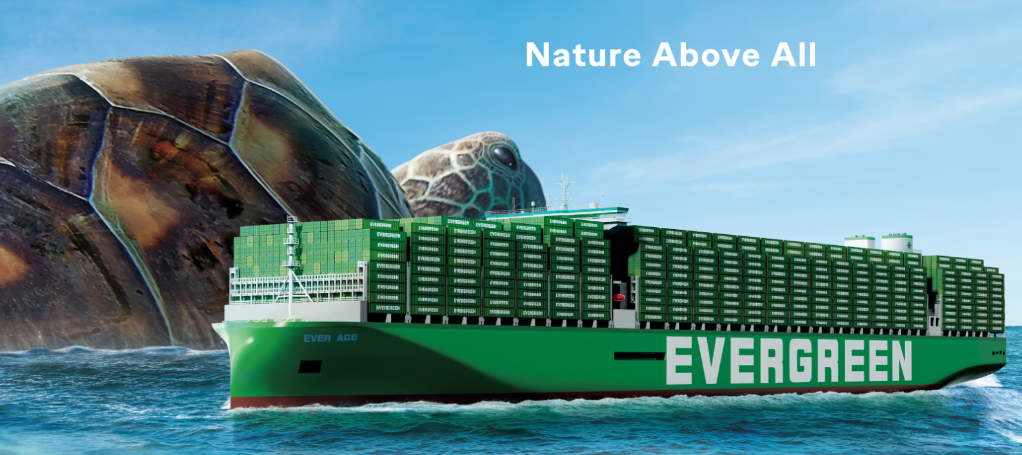
2025
LAAM Meeting (CARB)
By LAD/EGA/ELA 2025.FEB.27~28
By LAD/EGA/ELA

Slide 2
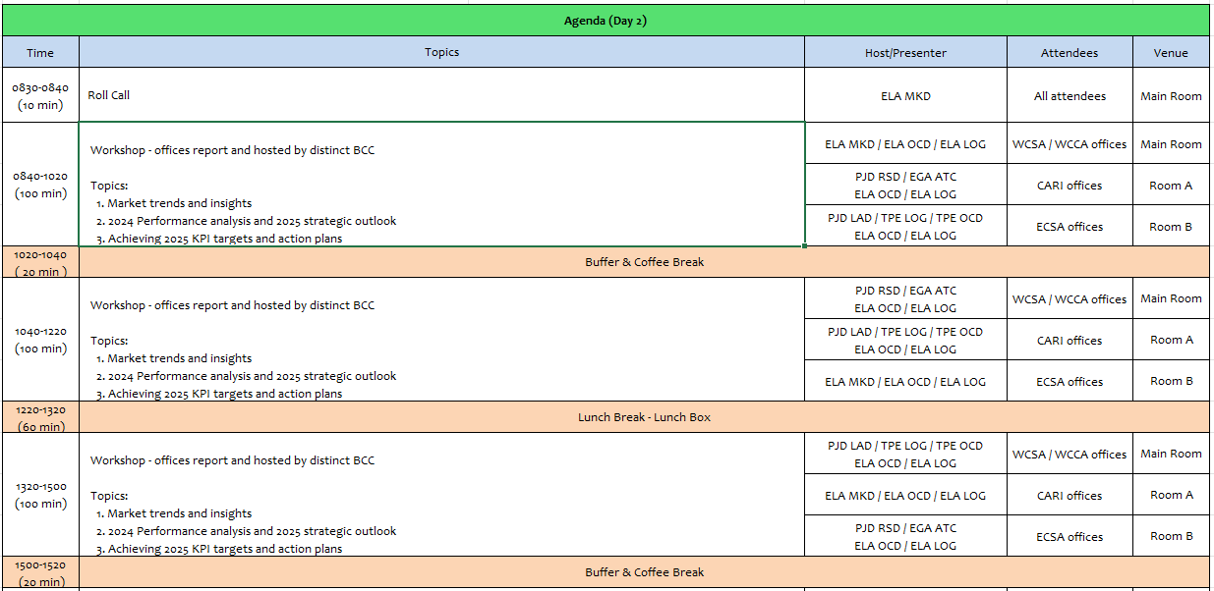
2

Slide 3
02
MIS
(COSTA RICA include NICARAGUA)

Slide 4
Performance/Space(2024) and 2025 Market Review (CR+NI)
Subject | Segments | BCC | 2024 Target TTL Loading(TEU) | 2024 JAN~DEC TTL Loading(TEU) | Achievement (%) | 2025 JAN~DEC TTL Loading(TEU) | Market Review & Action Plan (How to achieve 2025 target?)
 |  |  | (A) | (B) | (B)/(A) | Target
Trade Lane | F.E. => CR+NI IMP. (C Trade) | LAD | 127 | 212 | 167% | 245
 | F.E. => CR+NI IMP. (Q Trade) | LAD | 6,221 | 6,354 | 102% | 7,265
 | CR+NI EXP. => F.E. (CF Trade) | LAD | 5,483 | 5,106 | 93% | 5,140
Market review:
C trade is the non-natural routing for CR imports from F.E., if the rates and transit time are competitive compared to CRCAL, the accounts are willing to use CRMOB.
Action Plan: Request TPE support with competitive rates between CRCAL and CRMOB to promote more CRMOB.
Market review:
Cosco and Maersk have most of the market share volume.
LAE service schedule need to be more stable to increase volume.
China imports of electric cars is growing, we need POL support wend we send sales leads.
Tenders are a great way to increase market share.
Action Plan: - Focus on growing commodities, example, electric cars.
- Increase communication with POL to develop FOB & CIF accounts
Market review:
Wood and scrap are the main commodities, those commodities main PODs are in India.
Action Plan:
Motivate Evergreen to increase allocation in CIX services for Costa Rica & Nicaragua to increase the market share in India exports.
4

Slide 5
Performance/Space(2024) and 2025 Market Review (CR+NI)
Subject | Segments | BCC | 2024 Target TTL Loading(TEU) | 2024 JAN~DEC TTL Loading(TEU) | Achievement (%) | 2025 JAN~DEC TTL Loading(TEU) | Market Review & Action Plan (How to achieve 2025 target?)
 |  |  | (A) | (B) | (B)/(A) | Target
Trade Lane | CR+NI ⬄ USEC (609+610 Trade) | EGA-ATC | 1,000 | 1,476 | 147% | 1,800
 | CR+NI ⬄ CARB+WCCA (CB Trade) | ELA | 2,350 | 1,188 | 51% | 1,350
 | CR+NI ⬄ WCSA (CW+WC Trade) | ELA | 500 | 797 | 159% | 650
 | CR+NI ⬄ USEC (622+623 Trade) | ELA | 1,100 | 1,710 | 155% | 1,500
Market review:
USEC import market has potential accounts to target, however, decision makers are located at the U.S.
The extensive transit time to USEC affects Evergreen competitiveness.
Action Plan:
Promote reefer service to secure a lower transit time.
Market review:
Main volume for CB trade is from MX to CR.
Evergreen allocation for regional cargoes is low and almost zero in F.E. peak season.
Action Plan: Evergreen needs to grant more allocation for CR & NI in LAE service to develop the service.
Market review:
The competition offers lower transit times with lower rates.
Action Plan: Liner support is needed to offer to the customers better conditions, competitive rates and lower transit time.
Market review: It’s not the natural routing to/from the U.S., but there is always opportunity to capture new customers.
Action Plan: Request to liner steady LAE service and smooth cargo move from PABBA to PACCT for connecting.
5

Slide 6
Topic discussion (CR+NI)
Commercial side:
LAE service:
Regional business (MX-CR) can’t be developed as it should caused by the restricted allocation we are facing.
Evergreen need more space in LAE, 2024 far east peak season started in April, causing even more congestion at T/S ports.
CAW service:
The port rotation isn't helping our exports; it’s causing high transit times.
CIX services:
The impact of CIX low allocation for India ports, it’s causing an important restriction to our exports.
Transshipments:
Evergreen need to improve the waiting time at T/S ports (MXMZO – PABBA – PACCT).
Rates:
We have an special request to the BCCs, please honor the rates within the validity, we just had a case with a WC rate.
We encourage liner to find the way to always grant competitive rates.
Future Plan Suggestion:
LAE:
Increase allocation to reduce cargo rollover at T/S ports and be able to increase Far East and regional volume.
The number of vessels in LAE service from Cosco and Evergreen should be the same to increase our allocation.
CAW:
We invite Evergreen to review the port rotation and include CRMOB to a direct service with PACCT, PRSJU, DORHN, DOCAU to develop dry and reefer service.
6

Slide 7
Topic discussion (CR+NI)
Future market forecast in 2025 (Pessimistic / Optimistic / Remain the same)?
 | Get worse | Improve | Stay the same
2025 |  | X
Economic background.
The 2024 exports closed for Costa Rica with a 9% growth.
The OECD (Organization for Economic Cooperation and Development) and the Central bank expects that GDP will increase 3.9% for Costa Rica in 2025.
For Nicaragua the IMF expects that GDP will increase in 3.8%.
The exchange rate (USD-CRC) remains at a lower level, making exporters less competitive due to CR colon appreciation, promoting imports to the country.
7

Slide 8
Topic discussion (CR+NI)
Market share and Loading volume prospect 2025 (Long Haul)
 | FAR EAST - CR (MOIN + CALDERA) - JANUARY TO SEPTEMBER 2024
 |  | MARKET SHARE
 |  | CMA CGM | EVERGREEN | HAPAG LLOYD | MSC | MAERSK | ONE | %
 | 2024 | 15.02% | 11.67% | 11.52% | 15.52% | 34.14% | 12.13% | 100%
 |  | FAR EAST - CR (MOIN + CALDERA) / TEU'S
 |  | CMA CGM | EVERGREEN | HAPAG LLOYD | MSC | MAERSK | ONE | TOTAL Teu's
 | 2024 | 11,666 | 9,063 | 8,947 | 12,059 | 26,523 | 9,422 | 77,680
Nicaragua data not available
Volume prospect 2025
Despite the exposed situations, we will do our best to reach the liner KPI.
If the allocation and T/S situation improve, we will be able to increase market share for 2025
8

Slide 9
ECD/IMD Topic discussion (CR+NI)
ECD KPI | Item | 2023 | 2024 | Diff | Action Plan in 2025
ECD KPI | Storage |  |  |  | We need a steady Service in LAE arriving at CRCAL in order to avoid the storage charges
 | Lift on/off |  |  |  | We need depot les congested to be available to deliver the emty unit on a faster manner
 | Reposition |  |  |  | The Repo requested by LAE will be accomplish if We received the request on a weekly basis
 | M & R |  |  |  | N/A
IMD KPI | Cost Saving Project |  |  |  | N/A
 | 90% Onboard within 7 Days |  |  |  | Actually We depend of the FDR arriving to CRCAL in order to coordintate fast the repo requested by ELA
 | No Personal Negligence |  |  |  | N/A
Topic
Aged Container Selling / Free Reposition Plan
  A
  B
9

Slide 10
OCD/OPD Topic discussion (CR+NI)
 |  | 2023 | 2024 | Diff | Action Plan in 2025
OPD KPI | BOA |  |  |  | We continue working with the comercial BW given by the port, the issue is the LAE Service do not have a stable schedule
 | Port Stay |  |  |  | Actually the port infraestructure will remain the same until 2026
 | Productivity |  |  |  | The actual crane moves are 20-25 moves per hour due to port is working with 110% of capacity
OCD KPI | Incentive |  |  |  | N/A
 | Empty Storage |  |  |  | The capacity of the terminal empty storage depend on the operation percentage they are handling at this momento the terminal is 110% of capacity
 | Rate Reduction |  |  |  | There are no change on the actual charges at port
Topic
Terminal info update (expansion/dredge/crane)
  A
  B
10

Slide 11
03
CRE
(CURACAO)

Slide 12
Performance/Space(2024) and 2025 Market Review (CW)
Subject | Segments | BCC | 2024 Target TTL Loading(TEU) | 2024 JAN~DEC TTL Loading(TEU) | Achievement (%) | 2025 JAN~DEC TTL Loading(TEU) | Market Review & Action Plan (How to achieve 2025 target?)
 |  |  | (A) | (B) | (B)/(A) | Target
Trade Lane | F.E. => CW IMP. (C Trade) | LAD | 332 | 566 | 170% | 588
 | CW ⬄ USEC (609+610 Trade) | EGA-ATC | 20 | 16 | 80% | 20
 | CW ⬄ CARI (CC Trade) | EGA-ATC | 20 | 23 | 115% | 20
12

Slide 13
Performance/Space(2024) and 2025 Market Review (CW)
Subject | Segments | BCC | 2024 Target TTL Loading(TEU) | 2024 JAN~DEC TTL Loading(TEU) | Achievement (%) | 2025 JAN~DEC TTL Loading(TEU) | Market Review & Action Plan (How to achieve 2025 target?)
 |  |  | (A) | (B) | (B)/(A) | Target
Trade Lane | CW ⬄ WCSA (CW+WC Trade) | ELA | 10 | 0 | 0% | 10
 | CW ⬄ WCCA+CARO (CB Trade) | ELA | 15 | 0 | 0% | 10
13

Slide 14
Topic discussion (CW)
Commercial side:
Future Plan Suggestion:
14

Slide 15
Topic discussion (CW)
Future market forecast in 2025 (Pessimistic / Optimistic / Remain the same)?
Economic background.
Market share and Loading volume prospect 2025 (Long Haul)
 | Get worse | Improve | Stay the same
2025
15

Slide 16
ECD/IMD Topic discussion (CW)
ECD KPI | Item | 2022 | 2023 | Diff | Action Plan in 2025
ECD KPI | Storage
 | Lift on/off
 | Reposition
 | M & R
IMD KPI | Cost Saving Project
 | 90% Onboard within 7 Days
 | No Personal Negligence
16

Slide 17
OCD/OPD Topic discussion (CW)
 |  | 2022 | 2023 | Diff | Action Plan in 2025
OPD KPI | BOA
 | Port Stay
 | Productivity
OCD KPI | Incentive
 | Empty Storage
 | Rate Reduction
Topic
Terminal info update (expansion/dredge/crane)
  A
  B
17

Slide 18
04
SMS
(HAITI)

Slide 19
Performance/Space(2024) and 2025 Market Review (HT)
Subject | Segments | BCC | 2024 Target TTL Loading(TEU) | 2024 JAN~DEC TTL Loading(TEU) | Achievement (%) | 2025 JAN~DEC TTL Loading(TEU) | Market Review & Action Plan (How to achieve 2025 target?)
 |  |  | (A) | (B) | (B)/(A) | Target
Trade Lane | F.E. => HT IMP. (C Trade) | LAD | 1,219 | 1,450 | 119% | 1,715
 | HT ⬄ CARI+CARO (CB Trade) | ELA | 1,000 | 222 | 22% | 500
19

Slide 20
Performance/Space(2024) and 2025 Market Review (HT)
Subject | Segments | BCC | 2024 Target TTL Loading(TEU) | 2024 JAN~DEC TTL Loading(TEU) | Achievement (%) | 2025 JAN~DEC TTL Loading(TEU) | Market Review & Action Plan (How to achieve 2025 target?)
 |  |  | (A) | (B) | (B)/(A) | Target
Trade Lane | HT ⬄ WCSA+WCCA (CW+WC+CB Trade) | ELA | 1,000 | 60 | 6% | 80
 | HT ⬄ USEC (622+623 Trade) | ELA | 500 | 75 | 15% | 250
20

Slide 21
Topic discussion (HT)
Commercial side:
Future Plan Suggestion:
21

Slide 22
Topic discussion (HT)
Future market forecast in 2025 (Pessimistic / Optimistic / Remain the same)?
Economic background.
Market share and Loading volume prospect 2025 (Long Haul)
 | Get worse | Improve | Stay the same
2025
22

Slide 23
ECD/IMD Topic discussion (HT)
ECD KPI | Item | 2023 | 2024 | Diff | Action Plan in 2025
ECD KPI | Storage
 | Lift on/off
 | Reposition
 | M & R
IMD KPI | Cost Saving Project
 | 90% Onboard within 7 Days
 | No Personal Negligence
Topic
Aged Container Selling / Free Reposition Plan
  A
  B
23

Slide 24
OCD/OPD Topic discussion (HT)
 |  | 2023 | 2024 | Diff | Action Plan in 2025
OPD KPI | BOA
 | Port Stay
 | Productivity
OCD KPI | Incentive
 | Empty Storage
 | Rate Reduction
Topic
Terminal info update (expansion/dredge/crane)
  A
  B
24

Slide 25
05
MCD
(DOMINICAN REPUBLIC)

Slide 26
Performance/Space(2024) and 2025 Market Review (DO)
Subject | Segments | BCC | 2024 Target TTL Loading(TEU) | 2024 JAN~DEC TTL Loading(TEU) | Achievement (%) | 2025 JAN~DEC TTL Loading(TEU) | Market Review & Action Plan (How to achieve 2025 target?)
 |  |  | (A) | (B) | (B)/(A) | Target
Trade Lane | F.E. => DO IMP. (C Trade) | LAD | 2,708 | 2,530 | 96% | 4,900
26

Slide 27
Performance/Space(2024) and 2025 Market Review (DO)
Subject | Segments | BCC | 2024 Target TTL Loading(TEU) | 2024 JAN~DEC TTL Loading(TEU) | Achievement (%) | 2025 JAN~DEC TTL Loading(TEU) | Market Review & Action Plan (How to achieve 2025 target?)
 |  |  | (A) | (B) | (B)/(A) | Target
Trade Lane | DO ⬄ USEC (609+610 Trade) | EGA-ATC | 200 | 209 | 104% | 200
 | DO ⬄ CARI (CC Trade) | EGA-ATC | 2,900 | 3466 | 119% | 2,900
27

Slide 28
Performance/Space(2024) and 2025 Market Review (DO)
Subject | Segments | BCC | 2024 Target TTL Loading(TEU) | 2024 JAN~DEC TTL Loading(TEU) | Achievement (%) | 2025 JAN~DEC TTL Loading(TEU) | Market Review & Action Plan (How to achieve 2025 target?)
 |  |  | (A) | (B) | (B)/(A) | Target
Trade Lane | DO ⬄ WCSA (CW+WC Trade) | ELA | 150 | 21 | 14% | 50
 | DO ⬄ WCCA+CARO (CB Trade) | ELA | 300 | 70 | 23% | 100
28

Slide 29
Topic discussion (DO)
Commercial side:
Future Plan Suggestion:
29

Slide 30
Topic discussion (DO)
Future market forecast in 2025 (Pessimistic / Optimistic / Remain the same)?
Economic background.
Market share and Loading volume prospect 2025 (Long Haul)
 | Get worse | Improve | Stay the same
2025
30

Slide 31
ECD/IMD Topic discussion (DO)
ECD KPI | ITEM | 2023 | 2024 | Diff | Action Plan in 2025
ECD KPI | Storage
 | Lift on/off
 | Reposition
 | M & R
IMD KPI | Cost Saving Project
 | 90% Onboard within 7 Days
 | No Personal Negligence
Topic
Aged Container Selling / Free Reposition Plan
  A
  B
31

Slide 32
OCD/OPD Topic discussion (DO)
 | ITEM | 2023 | 2024 | Diff | Action Plan in 2025
OPD KPI | BOA
 | Port Stay
 | Productivity
OCD KPI | Incentive
 | Empty Storage
 | Rate Reduction
Topic
Terminal info update (expansion/dredge/crane)
  A
  B
32

Slide 33
06
LNM
(JAMAICA)

Slide 34
Performance/Space(2024) and 2025 Market Review (JM)
Subject | Segments | BCC | 2024 Target TTL Loading(TEU) | 2024 JAN~DEC TTL Loading(TEU) | Achievement (%) | 2025 JAN~DEC TTL Loading(TEU) | Market Review & Action Plan (How to achieve 2025 target?)
 |  |  | (A) | (B) | (B)/(A) | Target
Trade Lane | F.E. => JM IMP. (C Trade) | LAD | 379 | 339 | 90% | 490
 | JM ⬄ USEC (609+610 Trade) | EGA-ATC | 10 | 9 | 90% | 10
 | JM ⬄ CARI (CC Trade) | EGA-ATC | 25 | 28 | 112% | 25
34

Slide 35
Performance/Space(2024) and 2025 Market Review (JM)
Subject | Segments | BCC | 2024 Target TTL Loading(TEU) | 2024 JAN~DEC TTL Loading(TEU) | Achievement (%) | 2025 JAN~DEC TTL Loading(TEU) | Market Review & Action Plan (How to achieve 2025 target?)
 |  |  | (A) | (B) | (B)/(A) | Target
Trade Lane | JM ⬄ WCSA (CW+WC Trade) | ELA | 10 | 0 | 0% | 10
 | JM ⬄ WCCA+CARO (CB Trade) | ELA | 515 | 204 | 40% | 250
35

Slide 36
Topic discussion (JM)
Commercial side:
Future Plan Suggestion:
36

Slide 37
Topic discussion (JM)
Future market forecast in 2025 (Pessimistic / Optimistic / Remain the same)?
Economic background.
Market share and Loading volume prospect 2025 (Long Haul)
 | Get worse | Improve | Stay the same
2025
37

Slide 38
ECD/IMD Topic discussion (JM)
ECD KPI | ITEM | 2023 | 2024 | Diff | Action Plan in 2025
ECD KPI | Storage
 | Lift on/off
 | Reposition
 | M & R
IMD KPI | Cost Saving Project
 | 90% Onboard within 7 Days
 | No Personal Negligence
Topic
Aged Container Selling / Free Reposition Plan
  A
  B
38

Slide 39
OCD/OPD Topic discussion (JM)
 | ITEM | 2023 | 2024 | Diff | Action Plan in 2025
OPD KPI | BOA
 | Port Stay
 | Productivity
OCD KPI | Incentive
 | Empty Storage
 | Rate Reduction
Topic
Terminal info update (expansion/dredge/crane)
  A
  B
39

Slide 40
07
UMS
(PANAMA)

Slide 41
Performance/Space(2024) and 2025 Market Review (PA)
Subject | Segments | BCC | 2024 Target TTL Loading(TEU) | 2024 JAN~DEC TTL Loading(TEU) | Achievement (%) | 2025 JAN~DEC TTL Loading(TEU) | Market Review & Action Plan (How to achieve 2025 target?)
 |  |  | (A) | (B) | (B)/(A) | Target
Trade Lane | F.E. => PA IMP. (C Trade) | LAD | 15,512 | 17,444 | 112% | 16,415
 | PA ⬄ USEC (609+610 Trade) | EGA-ATC | 210 | 138 | 66% | 210
 | PA ⬄ CARI (CC Trade) | EGA-ATC | 5,700 | 4881 | 86% | 5,500
41

Slide 42
Performance/Space(2024) and 2025 Market Review (PA)
Subject | Segments | BCC | 2024 Target TTL Loading(TEU) | 2024 JAN~DEC TTL Loading(TEU) | Achievement (%) | 2025 JAN~DEC TTL Loading(TEU) | Market Review & Action Plan (How to achieve 2025 target?)
 |  |  | (A) | (B) | (B)/(A) | Target
Trade Lane | PA ⬄ WCSA (CW+WC Trade) | ELA | 310 | 289 | 93% | 310
 | PA ⬄ WCCA+CARO (CB Trade) | ELA | 950 | 291 | 31% | 350
42

Slide 43
Topic discussion (PA)
Commercial side:
Future Plan Suggestion:
43

Slide 44
Topic discussion (PA)
Future market forecast in 2025 (Pessimistic / Optimistic / Remain the same)?
Economic background.
Market share and Loading volume prospect 2025 (Long Haul)
 | Get worse | Improve | Stay the same
2025
44

Slide 45
ECD/IMD Topic discussion (PA)
ECD KPI | ITEM | 2023 | 2024 | Diff | Action Plan in 2025
ECD KPI | Storage
 | Lift on/off
 | Reposition
 | M & R
IMD KPI | Cost Saving Project
 | 90% Onboard within 7 Days
 | No Personal Negligence
Topic
Aged Container Selling / Free Reposition Plan
  A
  B
45

Slide 46
OCD/OPD Topic discussion (PA)
 | ITEM | 2023 | 2024 | Diff | Action Plan in 2025
OPD KPI | BOA
 | Port Stay
 | Productivity
OCD KPI | Incentive
 | Empty Storage
 | Rate Reduction
Topic
Terminal info update (expansion/dredge/crane)
  A
  B
46

Slide 47
08
PRIS
(PUERTO RICO)

Slide 48
Performance/Space(2024) and 2025 Market Review (PR)
Subject | Segments | BCC | 2024 Target TTL Loading(TEU) | 2024 JAN~DEC TTL Loading(TEU) | Achievement (%) | 2025 JAN~DEC TTL Loading(TEU) | Market Review & Action Plan (How to achieve 2025 target?)
 |  |  | (A) | (B) | (B)/(A) | Target
Trade Lane | F.E. => PR IMP. (618 Trade) | LAD | 6,511 | 9,247 | 142% | 9,800
 | PR ⬄ CARI (609+610 Trade) | EGA-ATC | 830 | 354 | 43% | 500
48

Slide 49
Performance/Space(2024) and 2025 Market Review (PR)
Subject | Segments | BCC | 2024 Target TTL Loading(TEU) | 2024 JAN~DEC TTL Loading(TEU) | Achievement (%) | 2025 JAN~DEC TTL Loading(TEU) | Market Review & Action Plan (How to achieve 2025 target?)
 |  |  | (A) | (B) | (B)/(A) | Target
Trade Lane | PR ⬄ WCSA (619+620 Trade) | ELA | 250 | 0 | 0% | 10
 | PR ⬄ WCCA+CARO (622+623 Trade) | ELA | 850 | 44 | 5% | 70
49

Slide 50
Topic discussion (PR)
Commercial side:
Future Plan Suggestion:
50

Slide 51
Topic discussion (PR)
Future market forecast in 2025 (Pessimistic / Optimistic / Remain the same)?
Economic background.
Market share and Loading volume prospect 2025 (Long Haul)
 | Get worse | Improve | Stay the same
2025
51

Slide 52
ECD/IMD Topic discussion (PR)
ECD KPI | ITEM | 2023 | 2024 | Diff | Action Plan in 2025
ECD KPI | Storage
 | Lift on/off
 | Reposition
 | M & R
IMD KPI | Cost Saving Project
 | 90% Onboard within 7 Days
 | No Personal Negligence
Topic
Aged Container Selling / Free Reposition Plan
  A
  B
52

Slide 53
OCD/OPD Topic discussion (PR)
 | ITEM | 2023 | 2024 | Diff | Action Plan in 2025
OPD KPI | BOA
 | Port Stay
 | Productivity
OCD KPI | Incentive
 | Empty Storage
 | Rate Reduction
Topic
Terminal info update (expansion/dredge/crane)
  A
  B
53

Slide 54
09
ISL
(TRINIDAD)

Slide 55
Performance/Space(2024) and 2025 Market Review (TT)
Subject | Segments | BCC | 2024 Target TTL Loading(TEU) | 2024 JAN~DEC TTL Loading(TEU) | Achievement (%) | 2025 JAN~DEC TTL Loading(TEU) | Market Review & Action Plan (How to achieve 2025 target?)
 |  |  | (A) | (B) | (B)/(A) | Target
Trade Lane | F.E. => TT IMP. (C Trade) | LAD | 130 | 0 | 0 | 10
55

Slide 56
Performance/Space(2024) and 2025 Market Review (TT)
Subject | Segments | BCC | 2024 Target TTL Loading(TEU) | 2024 JAN~DEC TTL Loading(TEU) | Achievement (%) | 2025 JAN~DEC TTL Loading(TEU) | Market Review & Action Plan (How to achieve 2025 target?)
 |  |  | (A) | (B) | (B)/(A) | Target
Trade Lane | TT ⬄ CARB (CB Trade) | ELA | 10 | 6 | 60% | 5
 | TT ⬄ WCSA (CW+WC Trade) | ELA | 10 | 0 | 0% | 5 | Continue to share market data and competitive rates from other carriers with our BCC. Aiming to offer more competitive rates to customers. Target per week is 10 TEU once competitive rates are offered. Enhance marketing communication by launching an Evergreen campaign which will build awareness of the line and services offered.
 | TT ⬄ WCCA (CB Trade) | ELA | 10 | 0 | 0% | 5 | Continue to share market data and competitive rates from other carriers with our BCC. Aiming to offer more competitive rates to customers. Target per week is 10 TEU once competitive rates are offered. Enhance marketing communication by launching an Evergreen campaign which will build awareness of the line and services offered.
56

Slide 57
Topic discussion (TT)
Commercial side:
Future Plan Suggestion:
57

Slide 58
Topic discussion (TT)
Future market forecast in 2025 (Pessimistic / Optimistic / Remain the same)?
Economic background.
Market share and Loading volume prospect 2025 (Long Haul)
 | Get worse | Improve | Stay the same
2025
58

Slide 59
ECD/IMD Topic discussion (TT)
ECD KPI | ITEM | 2023 | 2024 | Diff | Action Plan in 2025
ECD KPI | Storage
 | Lift on/off
 | Reposition
 | M & R
IMD KPI | Cost Saving Project
 | 90% Onboard within 7 Days
 | No Personal Negligence
Topic
Aged Container Selling / Free Reposition Plan
  A
  B
59

Slide 60
OCD/OPD Topic discussion (TT)
 | ITEM | 2023 | 2024 | Diff | Action Plan in 2025
OPD KPI | BOA
 | Port Stay
 | Productivity
OCD KPI | Incentive
 | Empty Storage
 | Rate Reduction
Topic
Terminal info update (expansion/dredge/crane)
  A
  B
60

Slide 61


