Slide 1
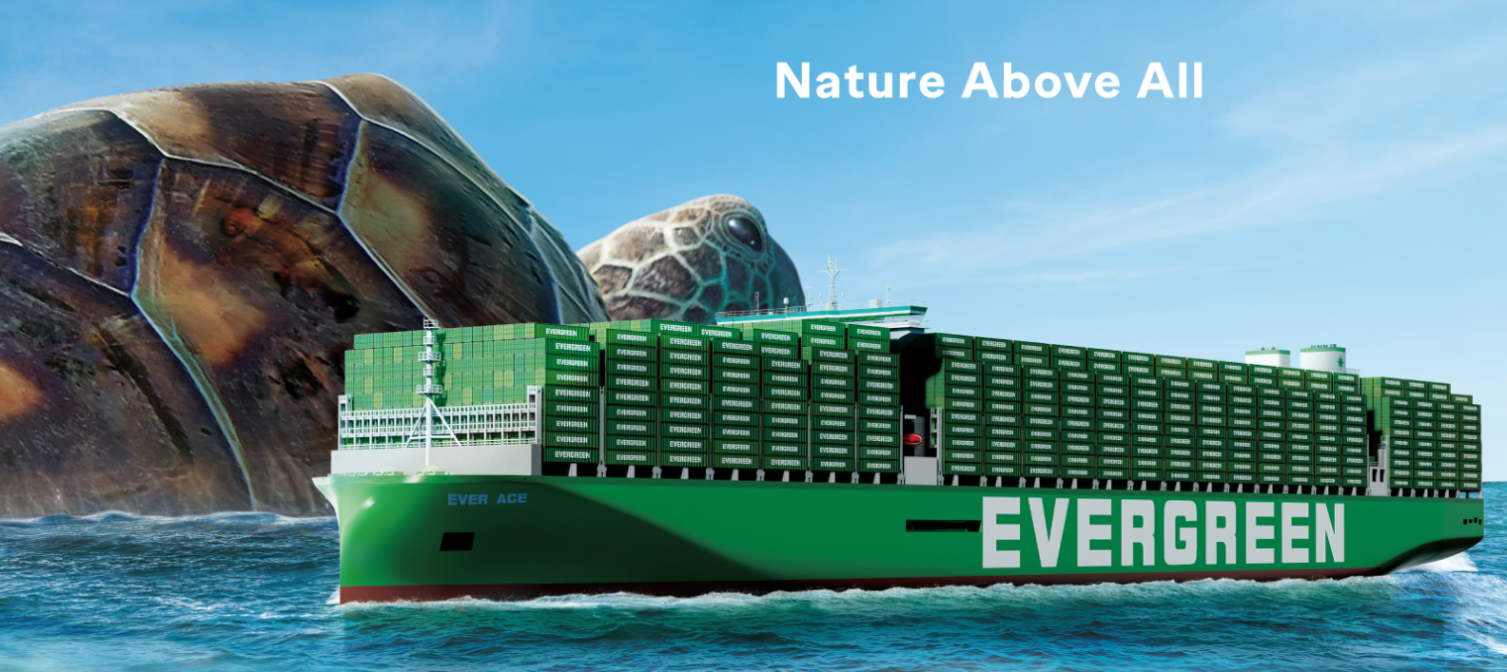
2025
LAAM FTF Meeting (CAME+WCCA)
By LAD/EGA/ELA 2025.FEB.27~28
By LAD/EGA/ELA

Slide 2
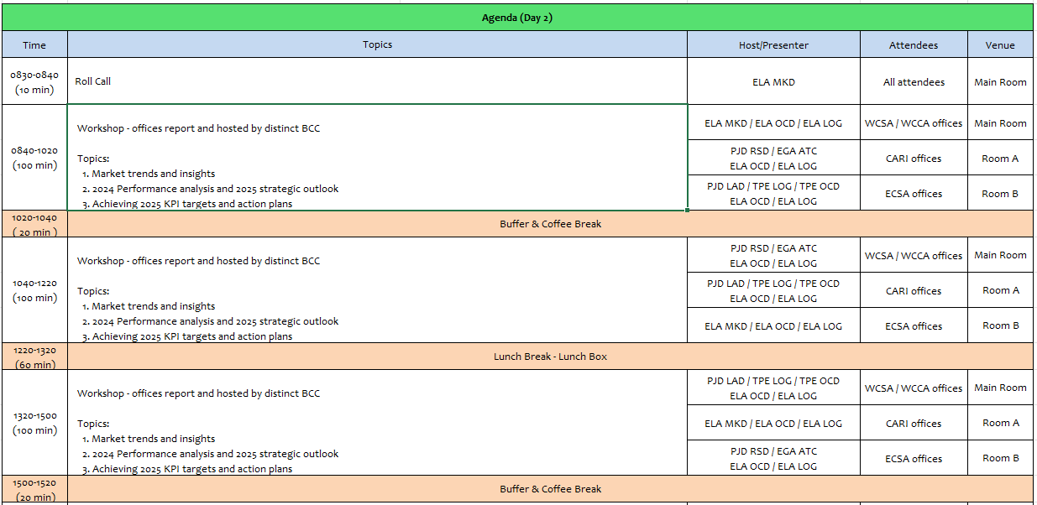
2

Slide 3
01
EMX
(MEXICO)

Slide 4
Performance/Space(2024) and 2025 Market Review (MX)
Subject | Segments | BCC | 2024 Target TTL Loading(TEU) | 2024 JAN~DEC TTL Loading(TEU) | Achievement (%) | 2025 JAN~DEC TTL Loading(TEU) | Market Review & Action Plan (How to achieve 2025 target?)
 |  |  | (A) | (B) | (B)/(A) | Target
Trade Lane | F.E. => MX IMP. (Q Trade) | LAD | 20,581 | 22,492 | 109% | 27,308 | Action plan, in order to enlarge our customers base list and get our target, we will be to achieve 2 new A/C regain 1 lost customer per month. Visit target at least 10 new and current customers per month, offering our allocation in our 4 service WSA/WSA2/WSA4/WSA5 persuade them to provide us better loading support this 2024. Catching more volume from Annual Tenders participated as: Walmart, Mabe, Soriana, Coppel and Mirage and try to get support for other VIP A/C like Italika and Chedraui.
 | MX EXP. => F.E. (Y Trade) | LAD | 8,948 | 10,771 | 120% | 12,959 | For Q1 maintain base volumes from two main A/C´s IMPALA TERMINAL/STEINWEG with ore concentrates regular cargo 600/700 TEU´s per month + regular FAK A/C´s to achieve around 320 TEU´s in weekly basis. Looking for cargo to base ports on WSA5 meanly, regain cargo to Asia southeast. For Q2/Q3/Q4 after MX government permissions release to export Iron Mineral we will focus in 2 A/C´s DOLPHIN & CIMA LOG looking for 400/500 TEU´s per month in order to get over 900 TEUS from all mineral exporters, rest of our volume will be get from medium size A/C as MAX EXPRESS, AMR SHIPPING,JJL PACIFIC, LA HANSIATICA KINTETSU WORLD,etc., + FAK from other small shots customers . Increase volumes from big shots customers 60/70% with comm., ORE/CONCENTRATES, REYICLED PELLET/HOME APPLIANCE+ 40/30% from FAK cargo.
4

Slide 5
Performance/Space(2024) and 2025 Market Review (MX)
Subject | Segments | BCC | 2024 Target TTL Loading(TEU) | 2024 JAN~DEC TTL Loading(TEU) | Achievement (%) | 2025 JAN~DEC TTL Loading(TEU) | Market Review & Action Plan (How to achieve 2025 target?)
 |  |  | (A) | (B) | (B)/(A) | Target
Trade Lane | MX ⬄ CARB (CB+V Trade) | ELA | 400 | 495 | 124% | 450 | Main PODs for V trade can be PABBA, having regular space on Express feeders or using WSA with T/S on Balboa KPI can be covered all depends on space asigned by BCC customers can supporting us MABE /LX PANTOS/MACOPA +FAK cargo, carribean cargo is very limited by MXMZO due to MX has natural east coast ports to CARI from MXVRC/MXALT.
 | MX ⬄ WCSA (CW+WC Trade) | ELA | 8,500 | 9,584 | 113% | 9,800 | -With current customers TENDER/FAK cargo without problem to achieve KPI MABE/LX PANTOS/P&G/ CORGO AGENTS this means 60% from volume asigned + small FAK cargo shippers 40% can be covered acheaving new accounts with better guide line rates.
 | MX ⬄ WCCA (CB Trade) | ELA | 1,300 | 1,583 | 122% | 1,450 | - Stable allocation on feeders will be de key to fulfill our KPI along of all 2025 MX allocation was 5 to 10 TEUs per week, we can grant 200 TEUS per month as having competitive rates and space as Mexican market is, KPI can be achieved without problem, base cargo that MX can provoide from MABE/MACOPA/FFW and general FAK exporters (small shippers)
5

Slide 6
Topic discussion (MX)
Commercial side:
Q trade: Get more space at main ports for Own SQ cargo
Booking confirmation as soon as possible in order to provide best service for our own SQ and avoid roll overs in POL.
Y trade: Focusing to maintain base volume from ORE/MINERAL from 4 main accounts IMPALA/STEINWEG/DOLPHIN/CIMA + medium size A/C’S, enlarge FAK A/C´s regain Southeast
Y trade: volume offering WSA5 service with bigger space, using WSA2/3 for small shots vol’s 4 main accounts IMPALA/YAVA/STEINWEG/DOLPHIN, rest of volume will be covered by current and new small shots A/C´S.
Future Plan Suggestion:
Q Trade: To increase our lifting and enlarge our participation in MXLZC more space allocation needed to cover areas as MXJMJ / MXUCK / MXVUJ / MXQRO where this area service can be covered.
Y Trade: Promote WSA/ WSA5 service for big volumes, O/O cargo for all trades.
CW/WCA/V/B Trades: achieve cargo from many medium and small A/C´S, BCC needs to grant space on each service to maintain our market participation.
6

Slide 7
Topic discussion (MX)
Future market forecast in 2025 (Pessimistic / Optimistic / Remain the same)?
Economic background.
Considering all the risk factors for the coming year, we anticipate that the economic slowdown will continue, with expected growth in 2025 of 0.8%, below the 1.4% of 2024.
The Mexican economy itself will face some additional challenges. Private investment is expected to decrease, and public investment is also likely to shrink in 2025. The peso will continue to slide downward slowly over 2025.
The unemployment rate in Mexico was forecast to continuously increase between 2024 and 2029 by in total 0.7 percentage points.
Mexico's economic growth is expected to slow in the coming years, with 2025 GDP projections revised down to 1% from a previous estimate of 1.2%
Inflation (3.5%) and interest rate forecasts (monetary policy rate of 8.0% by year-end).
Market share and Loading volume prospect 2024 (Long Haul)
Q trade MS 2024, 2,523,417 TEU´s EMC with 11.87%. 2025 MS volume to grow around 10%
Y trade MS 2024, 163,350 TEU´s EMC with 8.5%. 2025 MS volume to grow around 15%
 | Get worse | Improve | Stay the same
2025 |  |  | Remain the same
7

Slide 8
ECD/IMD Topic discussion (MX)
ECD KPI | Item | 2023 | 2024 | Diff | Action Plan in 2025
ECD KPI | Storage | $19,174 | $0 | $-19,174 | Properly arrange and monitor the number of gate-in empty containers. When the expected inventory is likely to exceed the free pool, efforts will also be made in advance to negotiate with the terminal for storage fee reductions. Additionally, based on the 2025 cargo volume forecast, EMX will request OCD for help to negotiate with the terminal to expand the free pool.
 | Lift on/off | $1,867,572 | $1,957,571 | $89,999 | Redirect empty containers to depots offering higher rebate rates, such as CIMA and TEP. During negotiations for new depots, efforts will be made to ensure that suppliers match the current highest rebate rates level and align LOLO fees with the most competitive market prices. Strict control measures will also be implemented to minimize the number of empty containers returned to depots offering low rebate rates and charging high LOLO fees.
 | Reposition | $6,756,686 | $7,857,250 | $1,100,564 | Increase the inland export container pickup volume and boost the empty repositioning along the cost-effective transport route to reduce empty repositioning costs
 | M & R | $3,950 | $2,033 | $-1,917 | The costs were incurred due to urgent repairs of empty and loaded containers. EMX will continue to work closely with ELA to rigorously review the necessity of each repair case and carry out repairs to the minimum required standards
8

Slide 9
OCD/OPD Topic discussion (MX)
 |  | 2023 | 2024 | Diff | Action Plan in 2025
OPD KPI | BOA | OUT OF WINDOW MXMZO 86% MXLZC 83% ON WINDOW MXMZO 92% MXLZC 100% | OUT OF WINDOW MXMZO 89% MXLZC 94% ON WINDOW MXMZO 97% MXLZC 95% | MXMZO 3% MXLZC 11% MXMZO 5% MXLZC -5% | MXZLO: Arrangements has been performed with local authorities in order to grant the pier availability upon arrival, anyhow there are some cases where we couldn't arrange it due to competition vessel were working before us. Actions to keep doing are keep constinous communication with port administrator in order to keep granting berth upon arrival MXLZC: Lazaro Cardenas has been congested by competition vessel due to recent new services, which now it has been more dificult to grant a pier availability to our good vessels, extra loaders has been granted with commercial team but due to competition started asking their berthing window we couldn’t arrange it upon arrival.
 | Port Stay | MXMZO 91% MXLZC 91% | MXMZO 83% MXLZC 64% | MXMZO -8% MXLZC -27% | We have manage to improve port stay in a way where we have negotiated on empty evacuation to be loaded directly from truck I/o going to yard and drop the empty, with this movement port stay has improve and terminal could focus in import attendance I/o managing the empties inside the yard
 | Productivity | MXMZO 44 MXLZC 61 | MXMZO 45 MXLZC 47 | MXMZO 1% MXLZC 14% | On this year 2025 TIMSA has bought 1 MOBILE CRANE Y 4 RTG in order to help the release and the attendance of import, this new mobile crane will help terminal to reach new generation vessel of 22 row and the RTG will help them the attendance of the import delivery and flow to the vessel operation.
9

Slide 10
14
NAV
(EL SALVADOR)

Slide 11
Performance/Space(2024) and 2025 Market Review (SV)
Subject | Segments | BCC | 2024 Target TTL Loading(TEU) | 2024 JAN~DEC TTL Loading(TEU) | Achievement (%) | 2025 JAN~DEC TTL Loading(TEU) | Market Review & Action Plan (How to achieve 2025 target?)
 |  |  | (A) | (B) | (B)/(A) | Target
Trade Lane | F.E. => SV IMP. (Q Trade) | LAD | 129 | 83 | 65% | 102
 | SV EXP. => F.E. (CF Trade) | LAD | 409 | 377 | 92% | 479
11

Slide 12
Performance/Space(2024) and 2025 Market Review (SV)
Subject | Segments | BCC | 2024 Target TTL Loading(TEU) | 2024 JAN~DEC TTL Loading(TEU) | Achievement (%) | 2025 JAN~DEC TTL Loading(TEU) | Market Review & Action Plan (How to achieve 2025 target?)
 |  |  | (A) | (B) | (B)/(A) | Target
Trade Lane | SV ⬄ USEC (622+623 Trade) | ELA | 580 | 23 | 4% | 50
 | SV ⬄ WCSA (CW+WC Trade) | ELA | 150 | 221 | 147% | 200
 | SV ⬄ WCCA+CARB (CB Trade) | ELA | 220 | 70 | 32% | 100
12

Slide 13
Topic discussion (SV)
Commercial Side:
Future Plan suggestion:
13

Slide 14
Topic discussion (SV)
Future market forecast in 2025 (Pessimistic / Optimistic / Remain the same)?
 | Get worse | Improve | Stay the same
2025
Economic Background
14

Slide 15
ECD/IMD Topic discussion (SV)
ECD KPI | Item | 2023 | 2024 | Diff | Action Plan in 2025
ECD KPI | Storage
 | Lift on/off
 | Reposition
 | M & R
IMD KPI | Cost Saving Project
 | 90% Onboard within 7 Days
 | No Personal Negligence
Topic
15

Slide 16
OCD/OPD Topic discussion (SV)
 |  | 2023 | 2024 | Diff | Action Plan in 2025
OPD KPI | BOA
 | Port Stay
 | Productivity
OCD KPI | Incentive
 | Empty Storage
 | Rate Reduction
Topic
Terminal info update (expansion/dredge/crane)
The expansion of the container yard at the port of Acajutla includes an area of ​​more than 91,000 m2. It also includes an area for refrigerated containers and heavy transport, to facilitate more than 7,000 monthly operations.
16

Slide 17
15
SNP
(GUATEMALA include BELIZE)

Slide 18
Performance/Space(2024) and 2025 Market Review (GT+BZ)
Subject | Segments | BCC | 2024 Target TTL Loading(TEU) | 2024 JAN~DEC TTL Loading(TEU) | Achievement (%) | 2025 JAN~DEC TTL Loading(TEU) | Market Review & Action Plan (How to achieve 2025 target?)
 |  |  | (A) | (B) | (B)/(A) | Target
Trade Lane | F.E. => GT+BZ IMP. (Q Trade) | LAD | 9,823 | 7,430 | 76% | 9,269
 | GT+BZ EXP. => F.E. (CF Trade) | LAD | 1,952 | 2,357 | 121% | 2,989
18

Slide 19
Performance/Space(2024) and 2025 Market Review (GT+BZ)
Subject | Segments | BCC | 2024 Target TTL Loading(TEU) | 2024 JAN~DEC TTL Loading(TEU) | Achievement (%) | 2025 JAN~DEC TTL Loading(TEU) | Market Review & Action Plan (How to achieve 2024 target?)
 |  |  | (A) | (B) | (B)/(A) | Target
Trade Lane | GT+BZ ⬄ USEC (622+623 Trade) | ELA | 2,350 | 499 | 21% | 700
 | GT+BZ ⬄ WCSA (CW+WC Trade) | ELA | 3,550 | 4,641 | 131% | 4,300
 | GT+BZ ⬄ WCCA+CARB (CB Trade) | ELA | 650 | 1,039 | 160% | 800
19

Slide 20
Topic discussion (GT)
Commercial side:
CAW Service
Q trade
.
CF trade
LAE S Service
WSA2 Service
20

Slide 21
Topic discussion (GT)
Future Plan Suggestion:
21

Slide 22
Topic discussion (GT)
Future market forecast in 2025 (Pessimistic / Optimistic / Remain the same)?
Economic background
 | Get worse | Improve | Stay the same
2025
22

Slide 23
ECD/IMD Topic discussion (GT)
ECD KPI | Item | 2023 | 2024 | Diff | Action Plan in 2025
ECD KPI | Storage
 | Lift on/off
 | Reposition
 | M & R
IMD KPI | Cost Saving Project
 | 90% Onboard within 7 Days
 | No Personal Negligence
23

Slide 24
OCD/OPD Topic discussion (GT)
 |  | 2023 | 2024 | Diff | Action Plan in 2025
OPD KPI | BOA
 | Port Stay
 | Productivity LAE
 | Productivity WSA2
OCD KPI | Incentive
 | Empty Storage
 | Rate Reduction
24

Slide 25
Topic discussion (BZ)
Commercial side:
Future Plan Suggestion:
25

Slide 26
Topic discussion (BZ)
Future market forecast in 2025 (Pessimistic / Optimistic / Remain the same)?
Economic background.
 | Get worse | Improve | Stay the same
2025
26

Slide 27
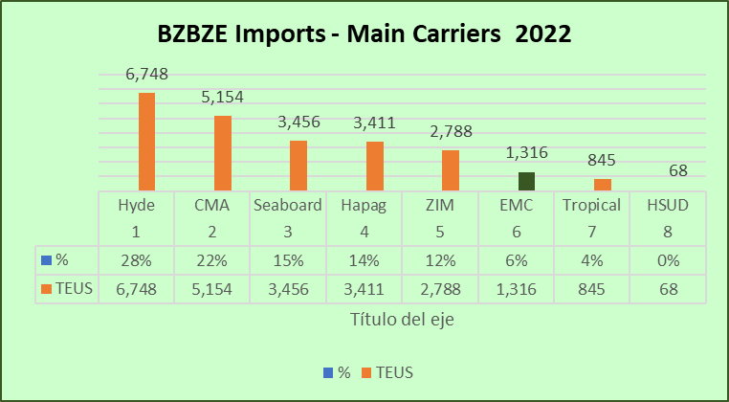
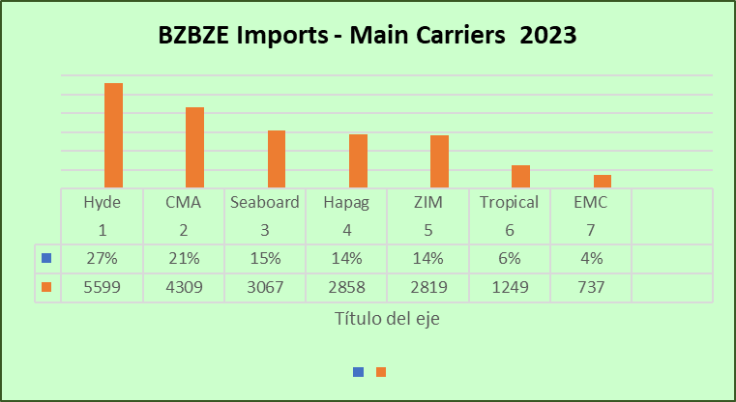
Topic discussion (BZ)
Market share and Loading volume prospect 2024 (Long Haul)
27

Slide 28
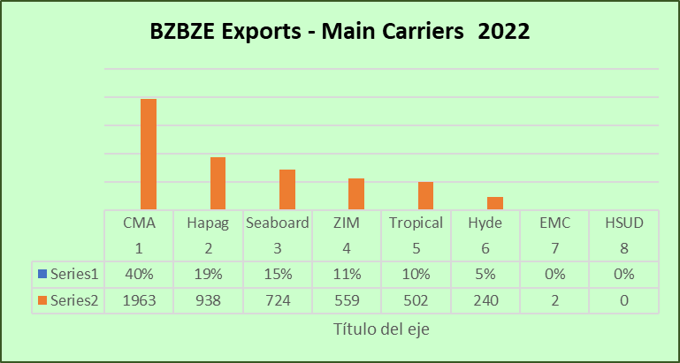
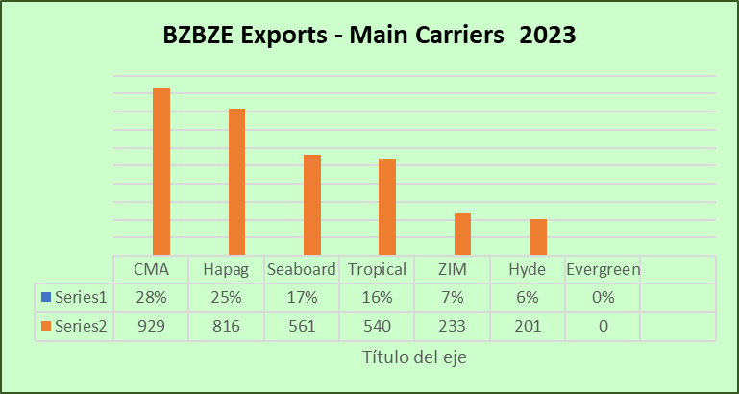
Topic discussion (BZ)
Market share and Loading volume prospect 2024 (Long Haul)
28

Slide 29
ECD/IMD Topic discussion (BZ)
ECD KPI | Item | 2023 | 2024 | Diff | Action Plan in 2024
ECD KPI | Storage
 | Lift on/off
 | (Ocean) Reposition
 | M & R
IMD KPI | Cost Saving Project
 | 90% Onboard within 7 Days
 | No Personal Negligence
Topic
Aged Container Selling / Free Reposition Plan
  A
  B
29

Slide 30
OCD/OPD Topic discussion (GT+BZ)
 |  | 2023 | 2024 | Diff | Action Plan in 2024
OPD KPI | BOA
 | Port Stay
 | Productivity
OCD KPI | Incentive
 | Empty Storage
 | Rate Reduction
Topic
Terminal info update (expansion/dredge/crane)
  A
  B
30

Slide 31
16
UNI
(HONDURAS)

Slide 32
Performance/Space(2024) and 2025 Market Review (HN)
Subject | Segments | BCC | 2024 Target TTL Loading(TEU) | 2024 JAN~DEC TTL Loading(TEU) | Achievement (%) | 2025 JAN~DEC TTL Loading(TEU) | Market Review & Action Plan (How to achieve 2025 target?)
 |  |  | (A) | (B) | (B)/(A) | Target
Trade Lane | F.E. => HN IMP. (Q Trade) | LAD | 1,766 | 1,513 | 86% | 1,754
 | F.E. => HN IMP. (C Trade) | LAD | 223 | 284 | 127% | 245
 | HN EXP. => F.E. (CF Trade) | LAD | 707 | 428 | 61% | 439
32

Slide 33
Performance/Space(2024) and 2025 Market Review (HN)
Subject | Segments | BCC | 2024 Target TTL Loading(TEU) | 2024 JAN~DEC TTL Loading(TEU) | Achievement (%) | 2025 JAN~DEC TTL Loading(TEU) | Market Review & Action Plan (How to achieve 2025 target?)
 |  |  | (A) | (B) | (B)/(A) | Target
Trade Lane | HN ⬄ USEC (622+623 Trade) | ELA | 800 | 286 | 36% | 500
 | HN ⬄ WCSA (CW+WC Trade) | ELA | 220 | 248 | 112% | 250
 | HN ⬄ WCCA+CARB (CB Trade) | ELA | 250 | 104 | 42% | 150
33

Slide 34
Topic discussion (HN)
Commercial side:
Future Plan Suggestion:
34

Slide 35
Topic discussion (HN)
Future market forecast in 2025 (Pessimistic / Optimistic / Remain the same)?
Economic background.
 | Get worse | Improve | Stay the same
2025
35

Slide 36
ECD/IMD Topic discussion (HN)
ECD KPI | Item | 2023 | 2024 | Diff | Action Plan in 2025
ECD KPI | Storage
 | Lift on/off
 | Reposition
 | M & R
IMD KPI | Cost Saving Project
 | 90% Onboard within 7 Days
 | No Personal Negligence
Topic
Aged Container Selling / Free Reposition Plan
  A
  B
36

Slide 37
OCD/OPD Topic discussion (HN)
 |  | 2023 | 2024 | Diff | Action Plan in 2025
OPD KPI | BOA
 | Port Stay
 | Productivity
OCD KPI | Incentive
 | Empty Storage
 | Rate Reduction
Topic
Terminal info update (expansion/dredge/crane)
  A
  B
37

Slide 38


